Slide 1
Chapter 1: Introduction

Slide 2
Outline
The Need for Databases
Data Models
Relational Databases
Database Design
Storage Manager
Query Processing
Transaction Manager

Slide 3
Database Management System (DBMS)
DBMS contains information about a particular enterprise
Collection of interrelated data
Set of programs to access the data
An environment that is both convenient and efficient to use
Database Applications:
Banking: transactions
Airlines: reservations, schedules
Universities: registration, grades
Sales: customers, products, purchases
Online retailers: order tracking, customized recommendations
Manufacturing: production, inventory, orders, supply chain
Human resources: employee records, salaries, tax deductions
Databases can be very large.
Databases touch all aspects of our lives
Notes:
3

Slide 4
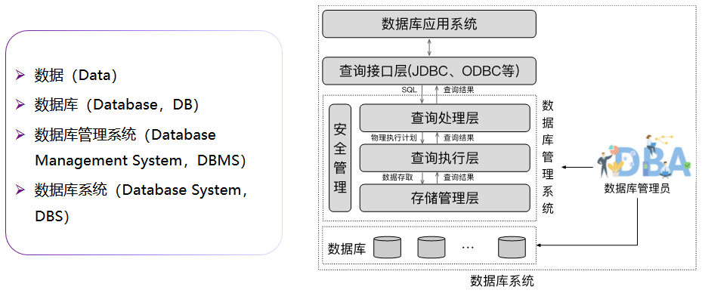
数据库的基本概念

Slide 5
University Database Example
Application program examples
Add new students, instructors, and courses
Register students for courses, and generate class rosters
Assign grades to students, compute grade point averages (GPA) and generate transcripts
In the early days, database applications were built directly on top of file systems
Notes:
5

Slide 6
Drawbacks of using file systems to store data
Data redundancy and inconsistency
Multiple file formats, duplication of information in different files
Difficulty in accessing data
Need to write a new program to carry out each new task
Data isolation
Multiple files and formats
Integrity problems
Integrity constraints (e.g., account balance > 0) become “buried” in program code rather than being stated explicitly
Hard to add new constraints or change existing ones
Notes:
6

Slide 7
Drawbacks of using file systems to store data (Cont.)
Atomicity of updates
Failures may leave database in an inconsistent state with partial updates carried out
Example: Transfer of funds from one account to another should either complete or not happen at all
Concurrent access by multiple users
Concurrent access needed for performance
Uncontrolled concurrent accesses can lead to inconsistencies
Example: Two people reading a balance (say 100) and updating it by withdrawing money (say 50 each) at the same time
Security problems
Hard to provide user access to some, but not all, data
Database systems offer solutions to all the above problems
Notes:
7

Slide 8
文件系统阶段
劳资科
学号
姓名
系别
补贴
学籍科
学号
姓名
系别
学分
学位
房产科
学号
姓名
系别
性别
住址
人事科
学号
姓名
系别
性别
学位
年龄
出身

Slide 9
数据库系统的特点
人事科
劳资科
系别
年龄
补贴
学位
学号
姓名
住址
学分
学籍科
性别
出身
房产科

Slide 10
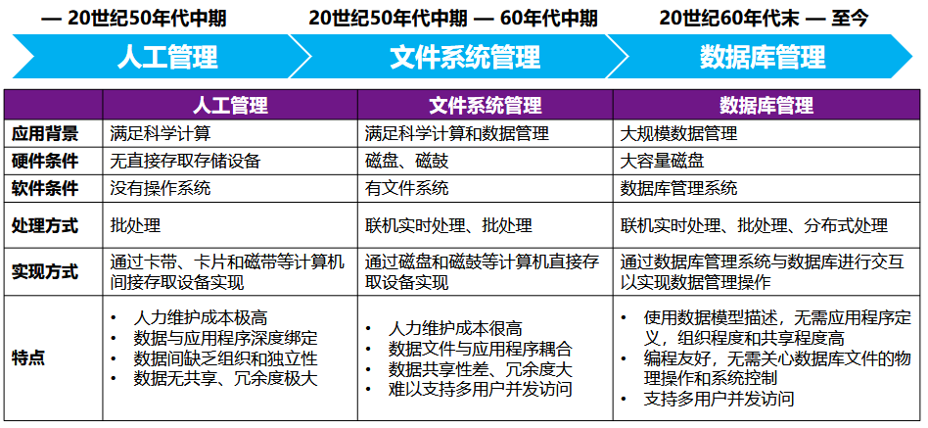
数据管理的三个阶段

Slide 11
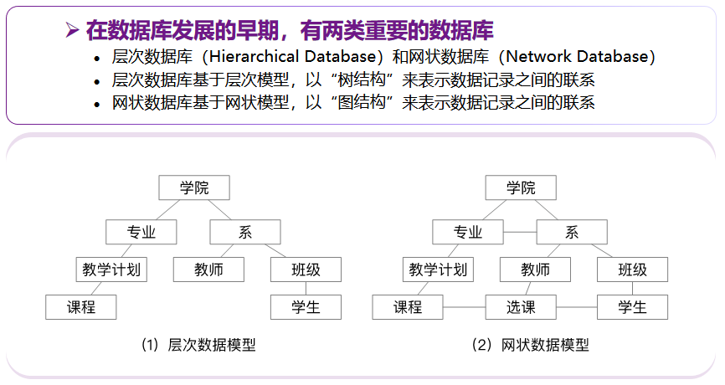
数据库模型：层次数据库和网状数据库

Slide 12
Levels of Abstraction
Physical level: describes how a record (e.g., instructor) is stored.
Logical level: describes data stored in database, and the relationships among the data.
type instructor = record
ID : string; name : string; dept_name : string; salary : integer;
end;
View level: application programs hide details of data types. Views can also hide information (such as an employee’s salary) for security purposes.
Notes:
12

Slide 13
View of Data
An architecture for a database system
Notes:
13

Slide 14
Instances and Schemas
Similar to types and variables in programming languages
Logical Schema – the overall logical structure of the database
Example: The database consists of information about a set of customers and accounts in a bank and the relationship between them
Analogous to type information of a variable in a program
Physical schema– the overall physical structure of the database
Instance – the actual content of the database at a particular point in time
Analogous to the value of a variable
Physical Data Independence – the ability to modify the physical schema without changing the logical schema
Applications depend on the logical schema
In general, the interfaces between the various levels and components should be well defined so that changes in some parts do not seriously influence others.
Notes:
14

Slide 15
Data Models
A collection of tools for describing
Data
Data relationships
Data semantics
Data constraints
Relational model
Entity-Relationship data model (mainly for database design)
Object-based data models (Object-oriented and Object-relational)
Semistructured data model (XML)
Other older models:
Network model
Hierarchical model
Notes:
15

Slide 16
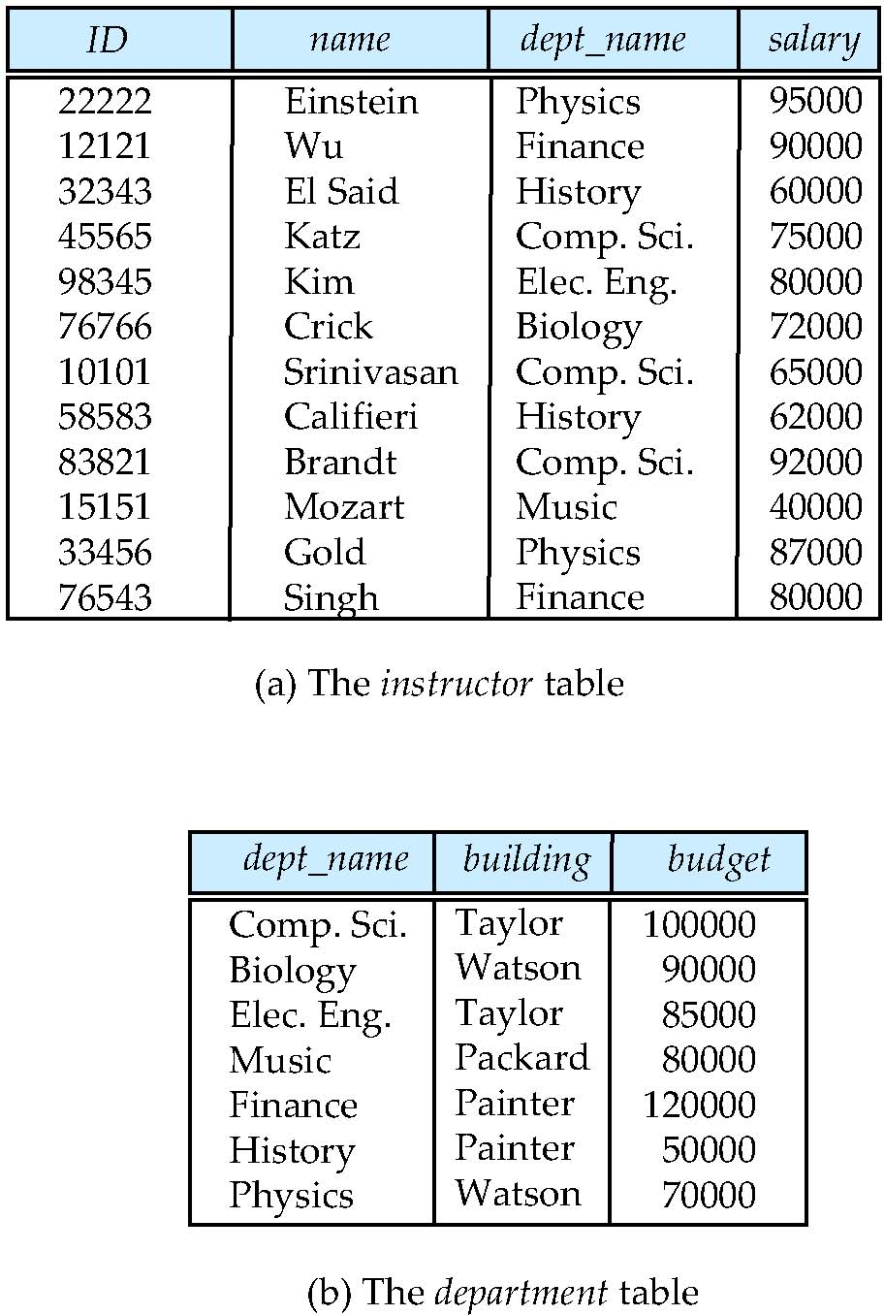
Relational Model
All the data is stored in various tables.
Example of tabular data in the relational model
Columns
Rows
Notes:
16

Slide 17
A Sample Relational Database
Notes:
17

Slide 18
Data Definition Language (DDL)
Specification notation for defining the database schema
Example: create table instructor ( ID char(5), name varchar(20), dept_name varchar(20), salary numeric(8,2))
DDL compiler generates a set of table templates stored in a data dictionary
Data dictionary contains metadata (i.e., data about data)
Database schema
Integrity constraints
Primary key (ID uniquely identifies instructors)
Authorization
Who can access what
Notes:
18

Slide 19
Data Manipulation Language (DML)
Language for accessing and manipulating the data organized by the appropriate data model
DML also known as query language
Two classes of languages
Pure – used for proving properties about computational power and for optimization
Relational Algebra
Tuple relational calculus
Domain relational calculus
Commercial – used in commercial systems
SQL is the most widely used commercial language
Notes:
19

Slide 20
SQL
The most widely used commercial language
SQL is NOT a Turing machine equivalent language
To be able to compute complex functions SQL is usually embedded in some higher-level language
Application programs generally access databases through one of
Language extensions to allow embedded SQL
Application program interface (e.g., ODBC/JDBC) which allow SQL queries to be sent to a database
Notes:
20
SQL is NOT a Turing machine equivalent language
SQL不像一个通用的图灵机那么强大，即有一些计算可以用通用的程序设计语言来表达，但无法通过SQL来表达

Slide 21
Database Design
The process of designing the general structure of the database:
Logical Design – Deciding on the database schema. Database design requires that we find a “good” collection of relation schemas.
Business decision – What attributes should we record in the database?
Computer Science decision – What relation schemas should we have and how should the attributes be distributed among the various relation schemas?
Physical Design – Deciding on the physical layout of the database
Notes:
21

Slide 22
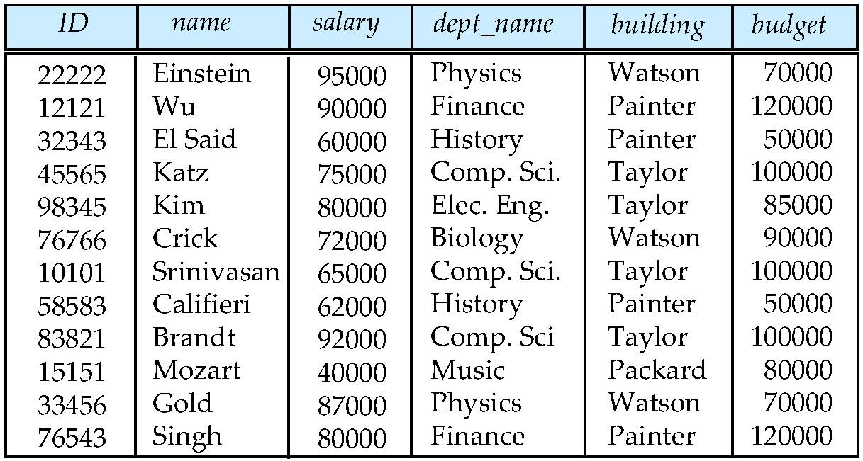
Database Design (Cont.)
Is there any problem with this relation?
Notes:
22

Slide 23
Design Approaches
Need to come up with a methodology to ensure that each of the relations in the database is “good”
Two ways of doing so:
Entity Relationship Model (Chapter 7)
Models an enterprise as a collection of entities and relationships
Represented diagrammatically by an entity-relationship diagram:
Normalization Theory (Chapter 8)
Formalize what designs are bad, and test for them
Notes:
23

Slide 24
Object-Relational Data Models
Relational model: flat, “atomic” values
Object Relational Data Models
Extend the relational data model by including object orientation and constructs to deal with added data types.
Allow attributes of tuples to have complex types, including non-atomic values such as nested relations.
Preserve relational foundations, in particular the declarative access to data, while extending modeling power.
Provide upward compatibility with existing relational languages.
Notes:
24

Slide 25
XML: Extensible Markup Language
Defined by the WWW Consortium (W3C)
Originally intended as a document markup language not a database language
The ability to specify new tags, and to create nested tag structures made XML a great way to exchange data, not just documents
XML has become the basis for all new generation data interchange formats.
A wide variety of tools is available for parsing, browsing and querying XML documents/data
Notes:
25

Slide 26
Database Engine
Storage manager
Query processing
Transaction manager
Notes:
26

Slide 27
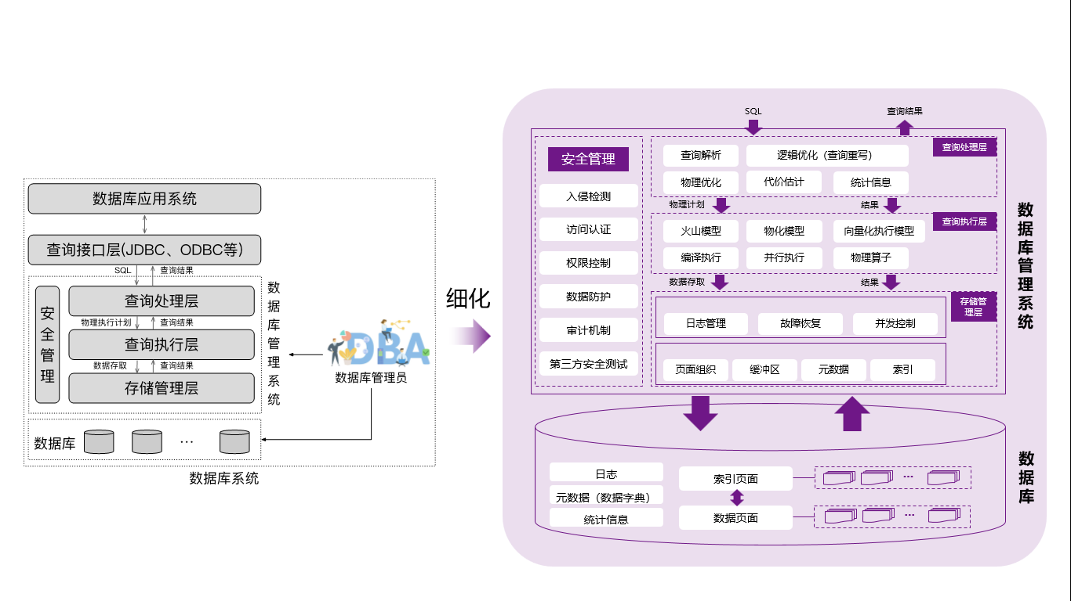
Database Engine

Slide 28
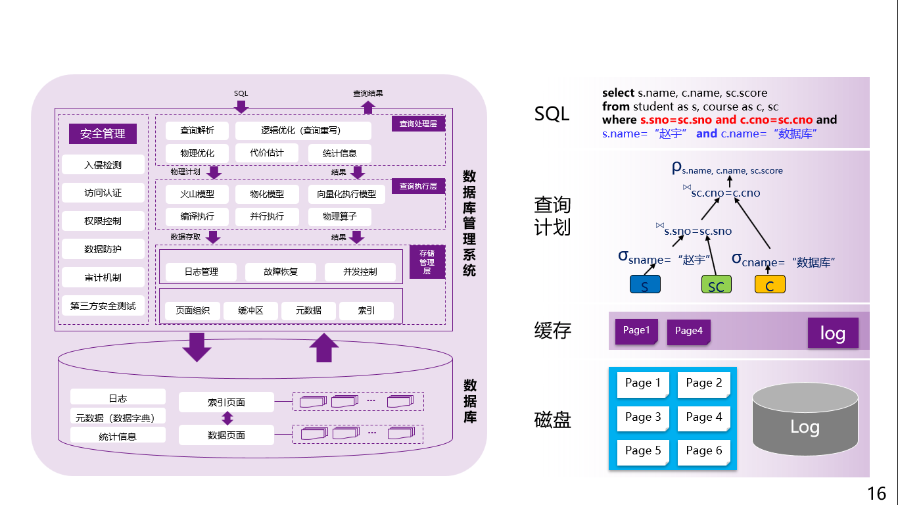
Database Engine

Slide 29
Storage Management
Storage manager is a program module that provides the interface between the low-level data stored in the database and the application programs and queries submitted to the system.
The storage manager is responsible to the following tasks:
Interaction with the OS file manager
Efficient storing, retrieving and updating of data
Issues:
Storage access
File organization
Indexing and hashing
Notes:
29

Slide 30
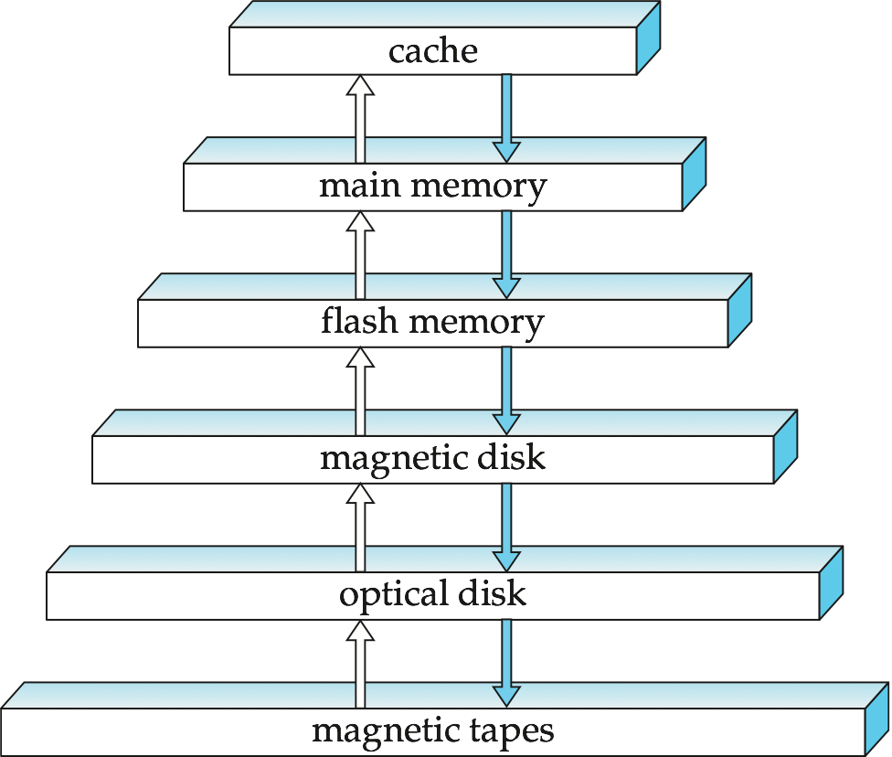
Storage Hierarchy
Notes:
cache：高速缓冲存储器：与数据库无关
flash memory：快闪存储器：USB口存取，与数据库无关
Optical disk：光盘

Slide 31
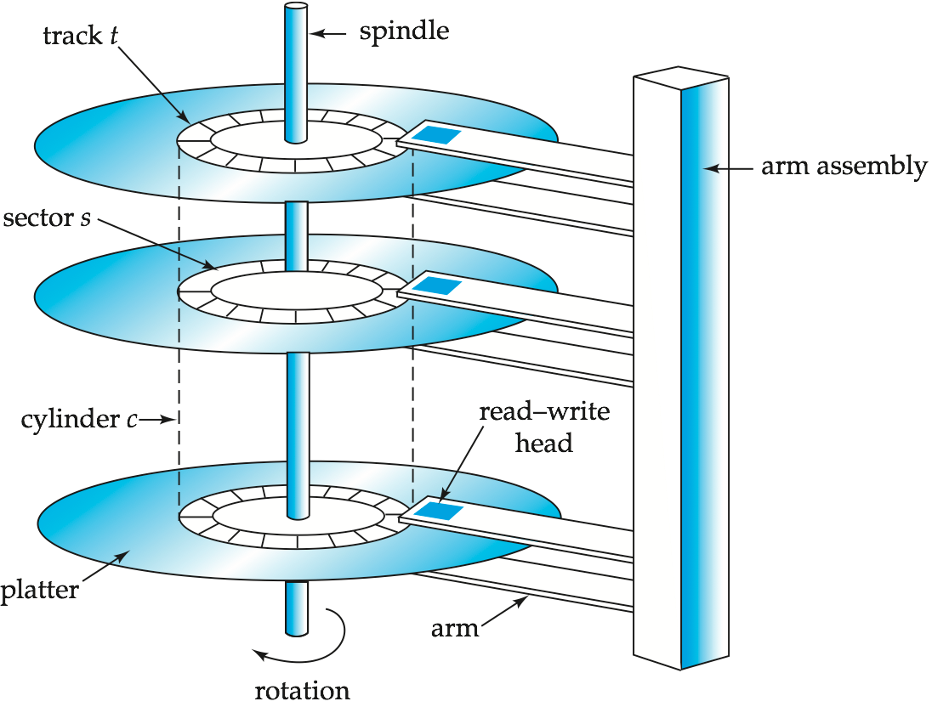
Magnetic Hard Disk Mechanism
NOTE: Diagram is schematic, and simplifies the structure of actual disk drives
Notes:
磁盘驱动器两个主要的移动部件：磁盘组合与磁头组合

Slide 32
Overview of Primary Components
User process
Instance
SGA
Shared pool
Library
cache
Database buffer cache
Redo log buffer cache
Server process
Data Dict. cache
PGA
PMON
SMON
DBWR
LGWR
CKPT
Others
Parameter
file
Data files
Control files
Redo log files
Archived
log files
Password
file
Database
Notes:
Overview of Primary Components
The Oracle architecture includes a number of primary components, which are discussed further in this lesson.
Oracle server: There are several files, processes, and memory structures in an Oracle server; however, not all of them are used when processing a SQL statement. Some are used to improve the performance of the database, ensure that the database can be recovered in the event of a software or hardware error, or perform other tasks necessary to maintain the database. The Oracle server consists of an Oracle instance and an Oracle database.
Oracle instance: An Oracle instance is the combination of the background processes and memory structures. The instance must be started to access the data in the database. Every time an instance is started, a System Global Area (SGA) is allocated and Oracle background processes are started. Background processes perform functions on behalf of the invoking process. They consolidate functions that would otherwise be handled by multiple Oracle programs running for each user. The background processes perform input/output (I/O) and monitor other Oracle processes to provide increased parallelism for better performance and reliability.
Oracle database: An Oracle database consists of operating system files, also known as database files, that provide the actual physical storage for database information. The database files are used to ensure that the data is kept consistent and can be recovered in the event of a failure of the instance.
Other key files: Nondatabase files are used to configure the instance, authenticate privileged users, and recover the database in the event of a disk failure.
User and server processes: The user and server processes are the primary processes involved when a SQL statement is executed; however, other processes may help the server complete the processing of the SQL statement.
Other processes: Many other processes exist that are used by other options within Oracle, such as Advanced Queuing, Real Application Clusters, Shared Server, Advanced Replication, and so on. These processes are discussed within their respective courses.

Slide 33
Query Processing
1. Parsing and translation
2. Optimization
3. Evaluation
Notes:
33

Slide 34
Query Processing (Cont.)
Alternative ways of evaluating a given query
Equivalent expressions
Different algorithms for each operation
Cost difference between a good and a bad way of evaluating a query can be enormous
Need to estimate the cost of operations
Depends critically on statistical information about relations which the database must maintain
Need to estimate statistics for intermediate results to compute cost of complex expressions
Notes:
34

Slide 35
Transaction Management
What if the system fails?
What if more than one user is concurrently updating the same data?
A transaction is a collection of operations that performs a single logical function in a database application
Transaction-management component ensures that the database remains in a consistent (correct) state despite system failures (e.g., power failures and operating system crashes) and transaction failures.
Concurrency-control manager controls the interaction among the concurrent transactions, to ensure the consistency of the database.
Notes:
35

Slide 36
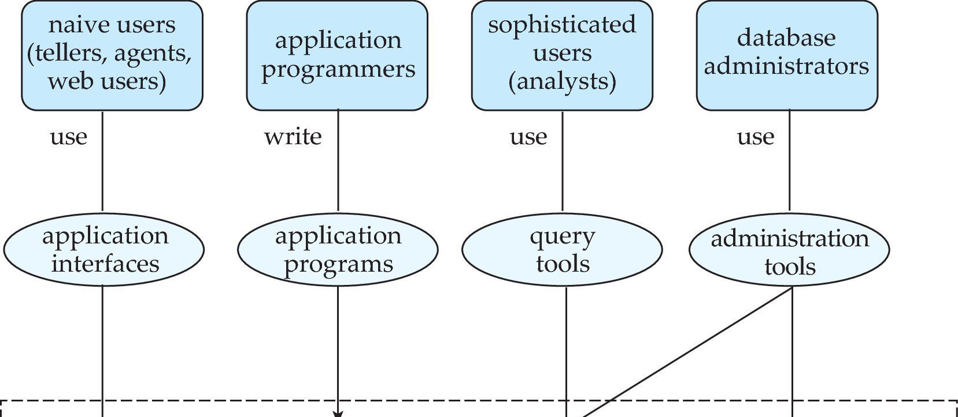
Database Users and Administrators
Database
Notes:
36

Slide 37
Database System Internals
Notes:
37

Slide 38
Database Architecture
The architecture of a database systems is greatly influenced by
the underlying computer system on which the database is running:
Centralized
Client-server
Parallel (multi-processor)
Distributed
Notes:
38

Slide 39
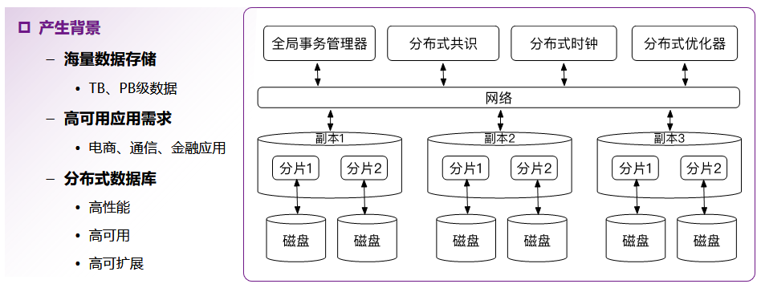
数据库架构：分布式数据库

Slide 40
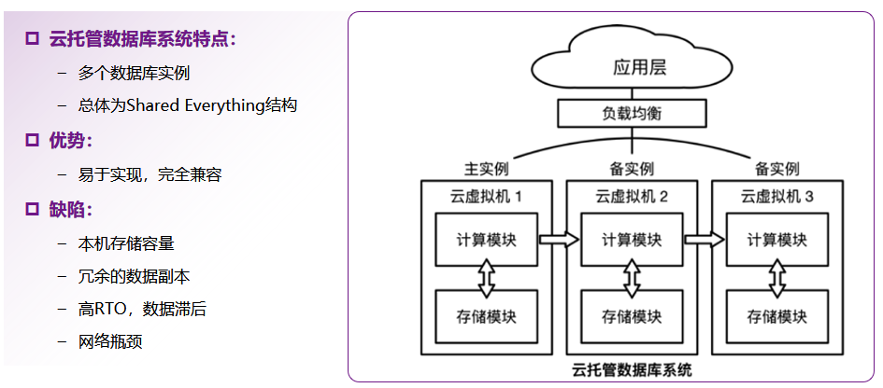
数据库架构：云托管数据库
Notes:
RTO:业务连续性术语，恢复时间目标
RPO:业务连续性术语，恢复点目标

Slide 41
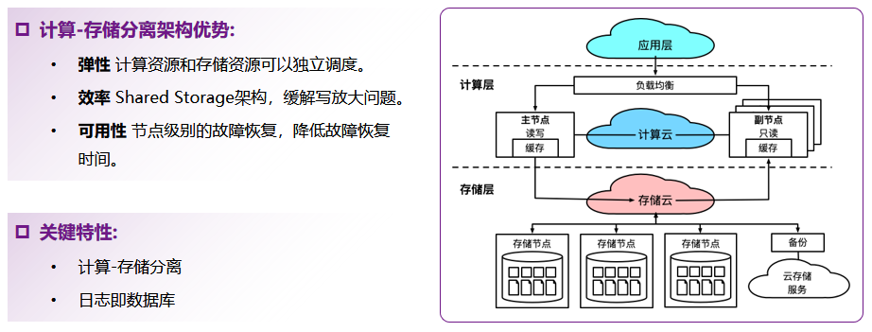
数据库架构：云原生数据库

Slide 42
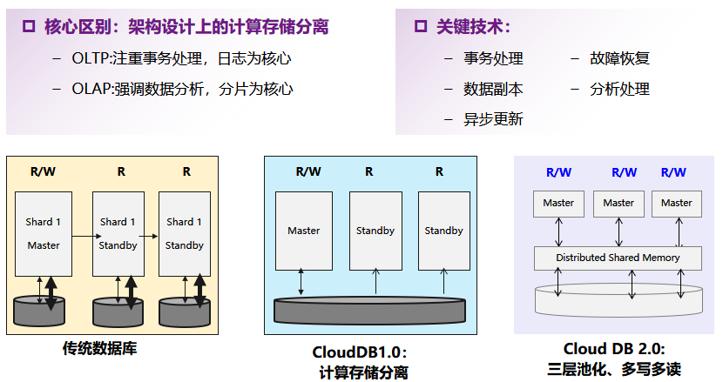
数据库架构：云原生数据库

Slide 43
History of Database Systems
1950s and early 1960s:
Data processing using magnetic tapes for storage
Tapes provided only sequential access
Punched cards for input
Late 1960s and 1970s:
Hard disks allowed direct access to data
Network and hierarchical data models in widespread use
Ted Codd defines the relational data model
Would win the ACM Turing Award for this work
IBM Research begins System R prototype
UC Berkeley begins Ingres prototype
High-performance (for the era) transaction processing
Notes:
43

Slide 44
History (cont.)
1980s:
Research relational prototypes evolve into commercial systems
SQL becomes industrial standard
Parallel and distributed database systems
Object-oriented database systems
1990s:
Large decision support and data-mining applications
Large multi-terabyte data warehouses
Emergence of Web commerce
Early 2000s:
XML and XQuery standards
Automated database administration
Later 2000s:
Giant data storage systems
Google BigTable, Yahoo PNuts, Amazon, ..
Notes:
44

Slide 45
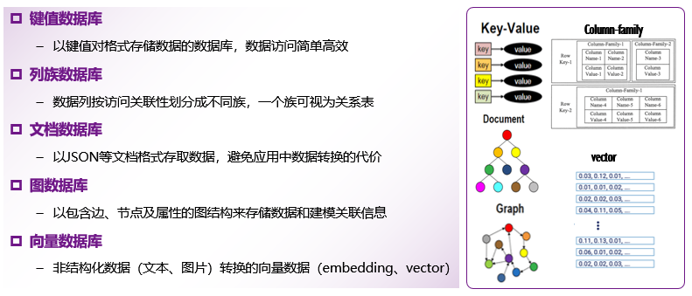
数据库模型： NoSQL数据库类型

Slide 46
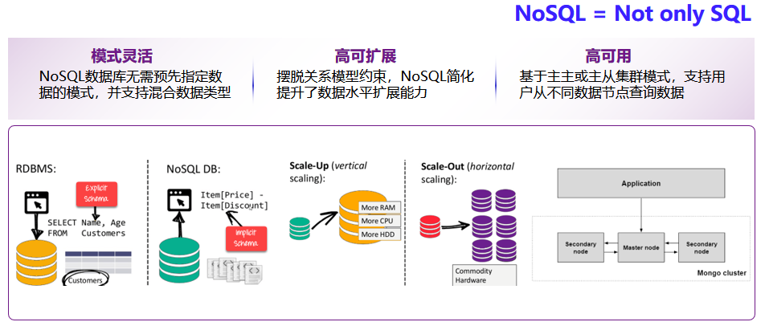
数据库模型： NoSQL数据库主要特点

Slide 47
数据库模型：常见的NoSQL数据库
主要类型 |  | NoSQL数据库产品（示例）
键值数据库 | 内存键值存储 | Redis, Memcached
 | 最终一致性键值存储 | Dynamo
 | 持久化键值存储 | LevelDB、RocksDB
列族数据库 |  | Cassandra, Hbase, Google BigTable
文档数据库 |  | MongoDB
图数据库 |  | Neo4J
向量数据库 |  | Milvus

Slide 48
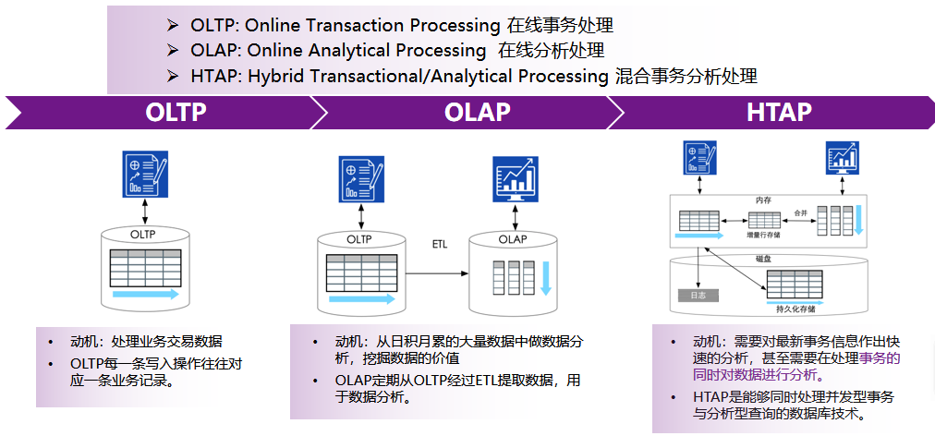
数据库各类应用： OLTP、OLAP与
HTAP数据库

Slide 49
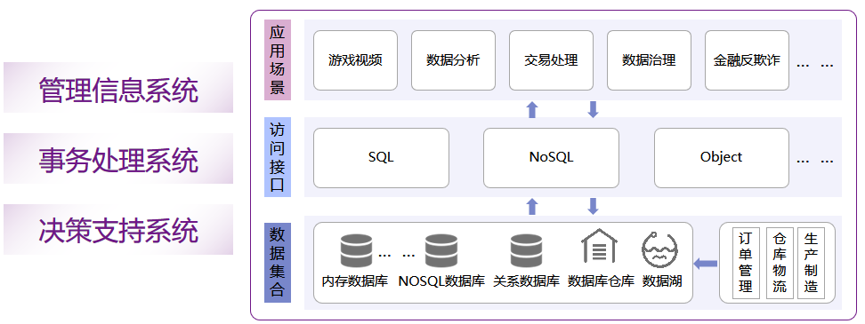
数据库各类应用

Slide 50
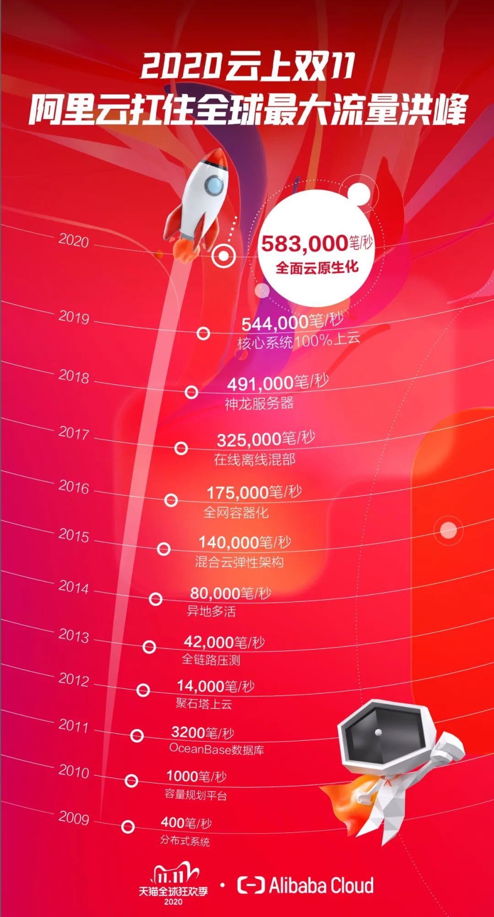

Slide 52
End of Chapter 1
Notes:
52

